Slide 1
REQUIREMENTS ENGINEERING

Slide 2
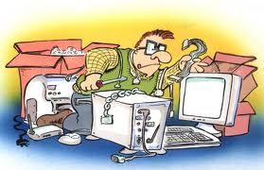
Requirements Elicitation

Slide 3
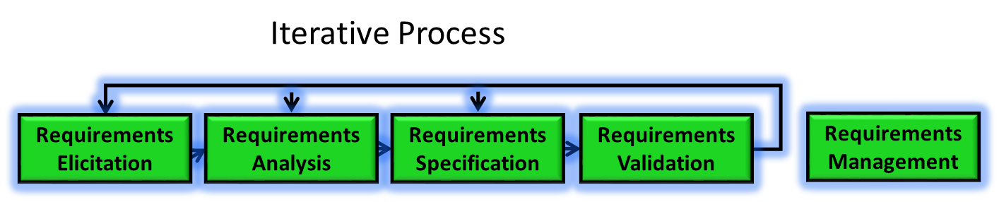
Requirements Elicitation process
Is a process of working proactively with all stakeholders gathering their needs, articulating their problem, identify and negotiate potential conflicts thereby establishing a clear scope and boundary for a project
It can also be described as a process of ensuring that the stakeholders have been identified and they have been given an opportunity to explain their problem and needs and describe what they would like the new system to do
V3.0 © 2011, IEEE All rights reserved
3

Slide 4
Requirements Elicitation process
Involves
Understanding the problem
Understanding the domain
Identifying clear objectives
Understanding the needs
Understanding constraints of the system stake holders
Writing business objectives for the project
V3.0 © 2011, IEEE All rights reserved
4

Slide 5
Requirements Elicitation process
Elicitation Techniques
The approach depends on
Nature of the system being developed
For example a UI intensive system needs a different approach compared to an embedded system as the navigation and behaviour is visible, so easy to comprehend
Background and experience of stakeholders
If the stakeholder is a very hands-on person then prototyping and simulation would work
For non-computer savvy persons documents would be necessary
5

Slide 6
Requirements Elicitation process
Elicitation Techniques
Active - where there are ongoing interaction between the stake holders and users. Some of the techniques are
interviews
facilitated meetings
role-playing
Prototypes
Ethnography (study/collect the system in its normal working surroundings)
Scenarios
Passive - infrequent interaction between the stake holders and users. E.g. use of
use cases
business process analysis and modelling
workflows
questionnaires
checklists
documentation
6

Slide 7
Requirements Analysis

Slide 8
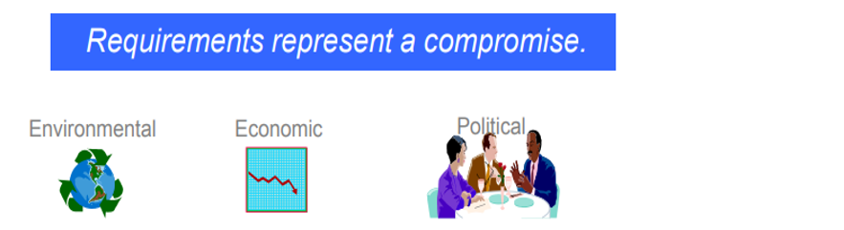
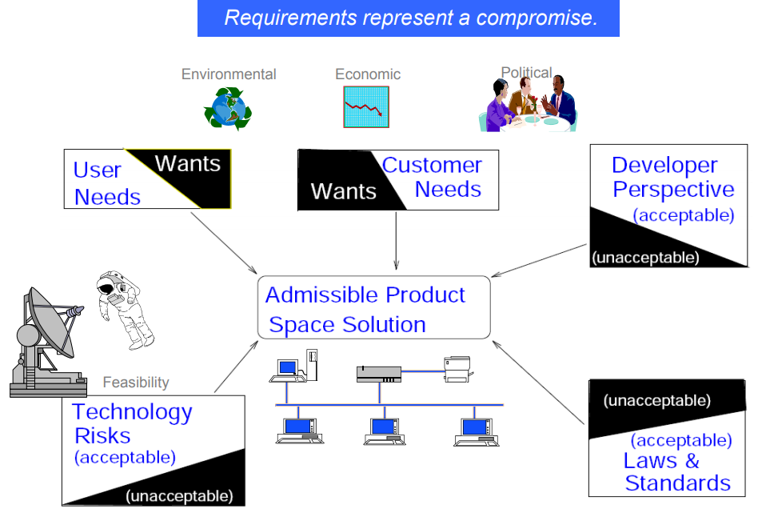
Requirements Analysis process
Iterative Process
Requirements Elicitation
Requirements Analysis
Requirements Specification
Requirements Validation
Requirements Management
V3.0 © 2011, IEEE All rights reserved

Slide 9

Requirements Analysis process
Iterative Process
Requirements Elicitation
Requirements Analysis
Requirements Specification
Requirements Validation
Requirements Management
Understand the requirements in depth, both from a product and process perspective
Classify and Organize the requirements into coherent clusters
Functional, Non-Functional & Domain requirements
System and User Requirements
Model the requirements
Analyze the requirements (if necessary) using fish bone diagram
9

Slide 10
Requirements Analysis process
Iterative Process
Requirements Elicitation
Requirements Analysis
Requirements Specification
Requirements Validation
Requirements Management
Recognize and resolve conflicts (e.g., functionality v. cost v. timeliness)
Negotiate Requirements
Prioritize the requirements (MoSCoW -Must have, Should have, Could have, Wont have)
Identify risks if any
Decide on Build or Buy (Commercial Of The Shelf Solution) and refine requirements
10

Slide 11

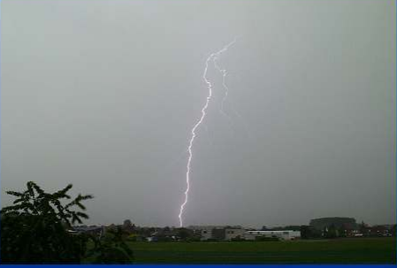
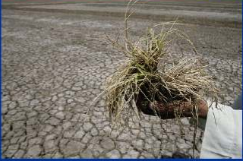
Requirements Analysis process
Iterative Process
Requirements Elicitation
Requirements Analysis
Requirements Specification
Requirements Validation
Requirements Management
Understand the requirements in depth, both from a product and process perspective
Requirement or Problem needs to be correctly internalized
Understand the requirements in depth, both from a product and process perspective
Classify and Organize the requirements into coherent clusters
Model the requirements
Analyze the requirements (if necessary) using fish bone diagram
Recognize and resolve conflicts (e.g., functionality v. cost v. timeliness)
Negotiate Requirements
Prioritize the requirements (MoSCoW -Must have, Should have, Could have, Wont have)
Identify risks if any
Decide on Build or Buy (Commercial Of The Shelf Solution) and refine requirements
Could be a problem to a game
A Storm coming in
Could be a blessing to a farmer

Slide 12
Requirements Analysis process
Iterative Process
Requirements Elicitation
Requirements Analysis
Requirements Specification
Requirements Validation
Requirements Management
Classify and Organize the requirements into coherent clusters
Functional, Non-Functional & Domain requirements
Understand the requirements in depth, both from a product and process perspective
Classify and Organize the requirements into coherent clusters
Model the requirements
Analyze the requirements (if necessary) using fish bone diagram
Recognize and resolve conflicts (e.g., functionality v. cost v. timeliness)
Negotiate Requirements
Prioritize the requirements (MoSCoW -Must have, Should have, Could have, Wont have)
Identify risks if any
Decide on Build or Buy (Commercial Of The Shelf Solution) and refine requirements
Functional Requirements
Functionality or services, the system should provide with different inputs, and expression on how the system should behave in particular situations
Could be written as high-level statements
Can be verified
This also indicates states what the system should not do
Example :
System shall assign a unique tracking number to each shipment
Non-Functional Requirements
Constraints on the services or functions offered by the system such as timing constraints, constraints on the development process, standards etc.
Often applied to the system as a whole rather than individual features or services.
Specify the criteria that can be used to judge the operation of the system
Example:
With 100 concurrent users a database record shall be fetched over the network in less than 3ms
Domain requirements Constraints on the system from the domain of operation

Slide 13
Requirements Analysis process
Iterative Process
Requirements Elicitation
Requirements Analysis
Requirements Specification
Requirements Validation
Requirements Management
Classify and Organize the requirements into coherent clusters (Cont.)
System and User requirements
Understand the requirements in depth, both from a product and process perspective
Classify and Organize the requirements into coherent clusters
Model the requirements
Analyze the requirements (if necessary) using fish bone diagram
Recognize and resolve conflicts (e.g., functionality v. cost v. timeliness)
Negotiate Requirements
Prioritize the requirements (MoSCoW -Must have, Should have, Could have, Wont have)
Identify risks if any
Decide on Build or Buy (Commercial Of The Shelf Solution) and refine requirements
User Requirements
Statements in natural language plus informal context diagrams system/sub-system and their interconnections and operational constraints. Written for/by customers.
System Requirements
A structured document setting out detailed descriptions of the system’s functions, services and operational constraints. Defines what should be implemented so may be part of a contract between client and contractor.
Also called Software requirements / Functional specifications

Slide 14
Requirements Analysis process
Iterative Process
Requirements Elicitation
Requirements Analysis
Requirements Specification
Requirements Validation
Requirements Management
Model the requirements
A Model is a representation of a system in some form. A is a Model of B if A can be used to answer questions about B
Understand the requirements in depth, both from a product and process perspective
Classify and Organize the requirements into coherent clusters
Model the requirements
Analyze the requirements (if necessary) using fish bone diagram
Recognize and resolve conflicts (e.g., functionality v. cost v. timeliness)
Negotiate Requirements
Prioritize the requirements (MoSCoW -Must have, Should have, Could have, Wont have)
Identify risks if any
Decide on Build or Buy (Commercial Of The Shelf Solution) and refine requirements
How would you represent a
Briefcase
Online Shopping
Briefcase
Model of a Briefcase
Briefcase
Capacity Weight
+ Open() + Close()
Other Examples of Models
Building Plan

Slide 15
Requirements Analysis process
Iterative Process
Requirements Elicitation
Requirements Analysis
Requirements Specification
Requirements Validation
Requirements Management
Modelling Systems (Cont.)
Goals for the models (or why models)
Understanding (existing) System
Analyzing and Validating the requirements in terms of visible requirements within the problem
Make modifications
Fix, Upgrade, Integrate
Communicating the requirements in terms of who, what and interpreting it in the same way
Should typically provide value to all stakeholders
Should help predict system behavior
“What if” analysis (financial models)
Test system
Performing tests when doing so on real systems are risky and expensive
Example: Test limits or breaking point
Should be Simple

Slide 16
Requirements Analysis process
Iterative Process
Requirements Elicitation
Requirements Analysis
Requirements Specification
Requirements Validation
Requirements Management
Modelling Systems (Cont.)
Structure Models
Captures static aspects of system
What entities exist in the system?
How are they related?
Example: Organization Chart
Behaviour Models
Captures dynamic aspects of the system
How do the entities interact in response to a stimulus?
Example: Process
PROBLEM
Solution
Analysis Model
Analysis Model
Problem Space Solution Space
Models could Informal e.g. Prose or could Simple Procedural e.g. Flowcharts or Pseudo Code or could be formal static models like ER diagrams or dynamic models.

Slide 17
Requirements Analysis process
Iterative Process
Requirements Elicitation
Requirements Analysis
Requirements Specification
Requirements Validation
Requirements Management
Modelling Systems (Cont.)
Some Simple Models
Browser
Web Server
HTTP Response
HTTP is an Application Layer Protocol (Defined in RFC 2616 of IETF)
Specifies what messages are exchanged between Client and Server (but not how they are transported)
Web Server
API
Applications, Databases
TCP
They could be UML based models like Use Case models (we will discuss this in more detail next class)

Slide 18
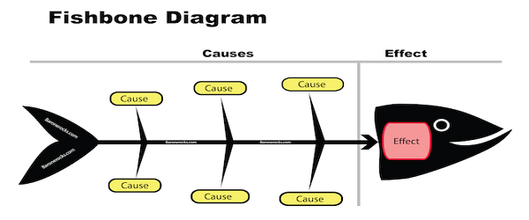
Requirements Analysis process
Iterative Process
Requirements Elicitation
Requirements Analysis
Requirements Specification
Requirements Validation
Requirements Management
Analyze the requirements using fish bone diagram
List out all the reasons/causes on why the requirement (effect) has come in and become relevant
Understand the requirements in depth, both from a product and process perspective
Classify and Organize the requirements into coherent clusters
Model the requirements
Analyze the requirements (if necessary) using fish bone diagram
Recognize and resolve conflicts (e.g., functionality v. cost v. timeliness)
Negotiate Requirements
Prioritize the requirements (MoSCoW -Must have, Should have, Could have, Wont have)
Identify risks if any
Decide on Build or Buy (Commercial Of The Shelf Solution) and refine requirements

Slide 19
Requirements Analysis process
Iterative Process
Requirements Elicitation
Requirements Analysis
Requirements Specification
Requirements Validation
Requirements Management
Recognize and Resolve Conflicts
Functionality Vs Cost Vs timelines
Negotiate requirements
Prioritize the requirements (MoSCoW -Must have, Should have, Could have, Won’t have)
Pareto Analysis (80-20 to focus on vital few to trivial many)
Identify risks if any
Decide on Build or Buy (Commercial Of The Shelf Solution- COTS) and refine requirements

